Slide 1
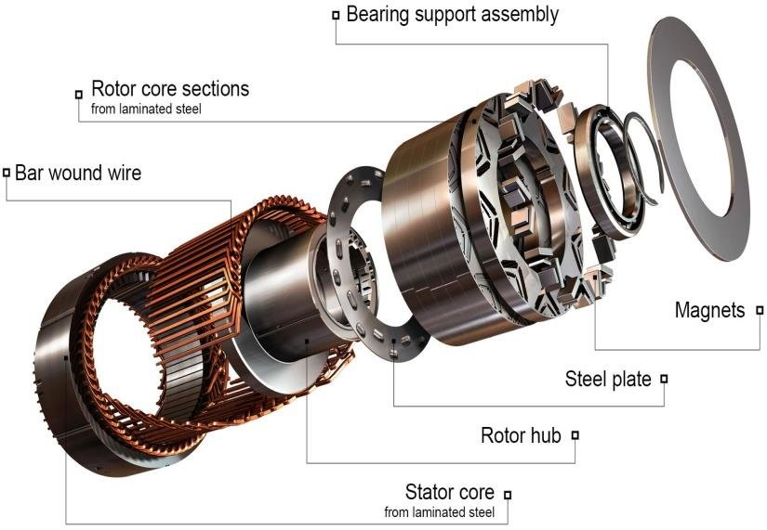
Predict Motor Speed based on other attributes available
Group 4
Shivam, Sai, Nithisvi, Madhuri

Slide 2
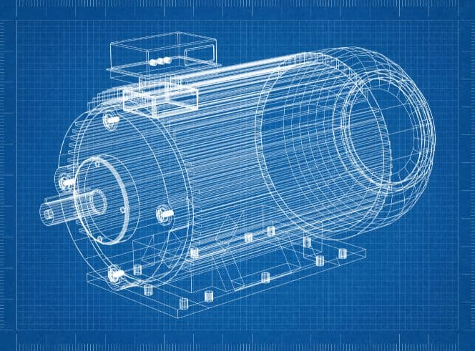
Objective
Predict Motor Speed based on other attributes available.

Slide 3
Project Flow
1
1
Business Problem
2
Exploratory Data Analysis
3
Model Building
Model Evaluation
4
4
Deployment
5
5
5
5
5
5
5

Slide 4
Business Problem
Predict Motor Speed based on other attributes available.
Temperature
Ambient Temperature
Coolant Temperature
Current
Current d-component
Current q-component
Features Sets
Voltage
Voltage d-component
Voltage q-component
Permanent Magnet surface temperature
Torque
Stator
Stator yoke temperature
Stator tooth temperature
Stator winding temperature

Slide 5
Python Packages Used
Scikit-learn
Python Package for Machine Learning Models
Numpy
Python Package for linear algebra and array access
Pandas
Python Package for Reading the Dataset
Matplotlib
Python Package for Visualization
TensorFlow
Python Package for Deep learning Models

Slide 6
Exploratory Data Analysis (EDA) and Feature Engineering
There are 998070 rows and 13 columns in the dataset.
No Null Fields.
Outiers Observed in ambient , u_d , torque , i_q , pm independent Features.
High Correlation Between Independent Variables. This Could lead to problem with model’s performance due to multi-collinearity.

Slide 7
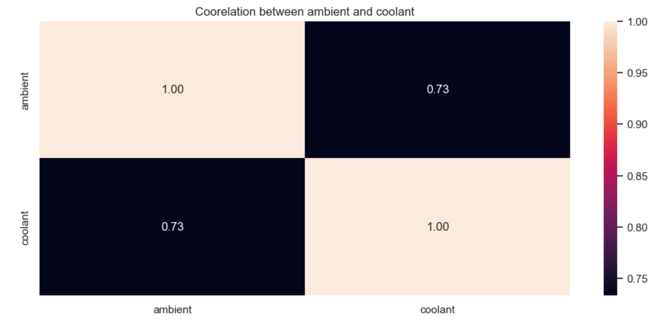
Ambient & Coolant
High Correlation Between these Independent Columns.

Slide 8
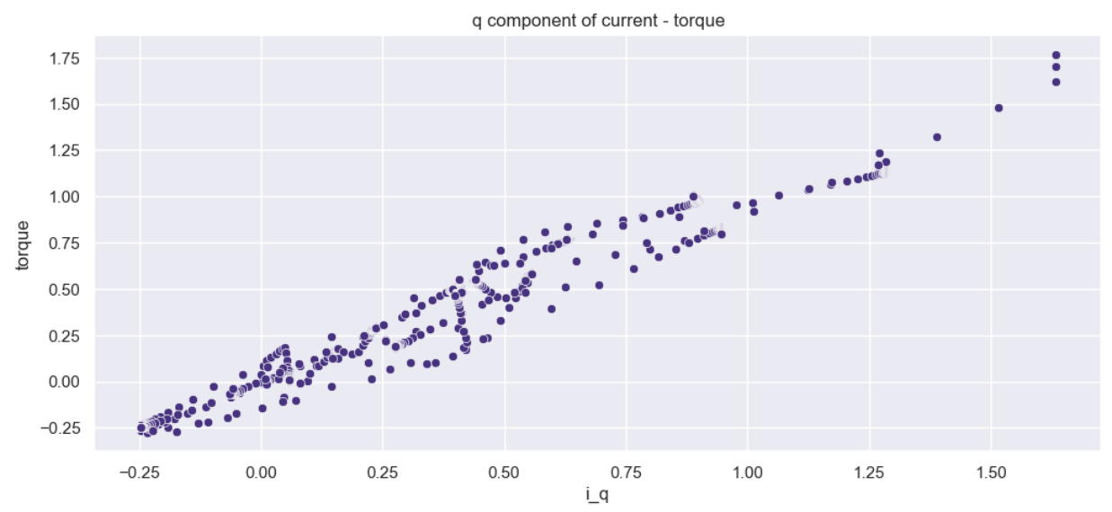
Torque & Q component Current
High Correlation between these Components.

Slide 9
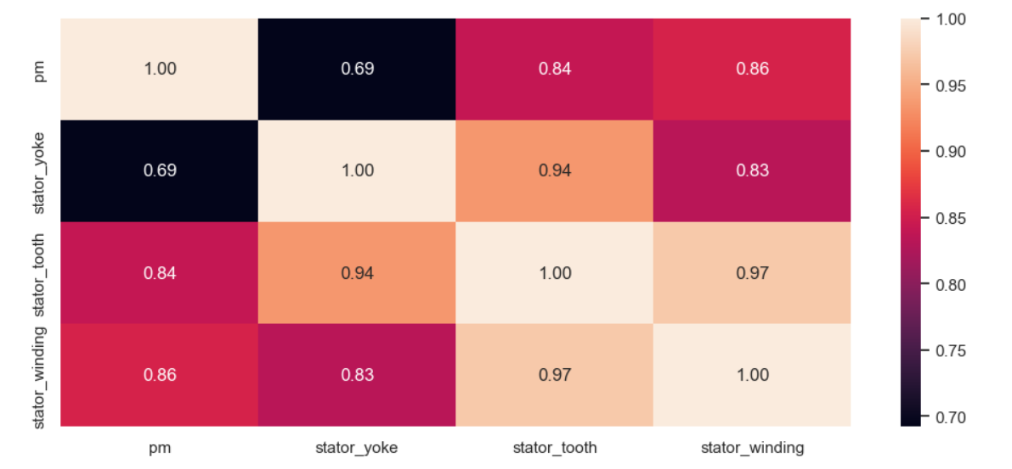
PM , Stator Yoke, Stator tooth, Stator Winding
High Correlation Amongst these Features.

Slide 10
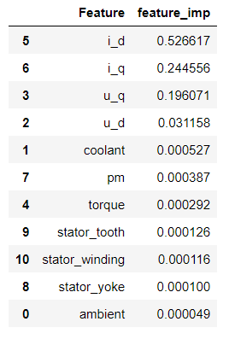
Feature Engineering
For Feature Engineering we used Decision Tree to find important Features that hugely affect out Dependent Feature.

Slide 11
Model Building
We Used Both Linear and Non Linear Models and Variations of the same.
Main Models Used are :
SGD Regressor
Catboost Regressor
Ordinary Least Square Model
Bayesian Ridge Regressor
Ridge Regressor
KNN Regressor
Random Forest Regressor
Dense Model

Slide 12
Model Evaluation
 | Models | Scaled | R_Squared (Train) | R_Squared (Test) | MSE (Train) | MSE (Test) | MAE (Train) | MAR (Test)
0 | OLS PCA SINGLE SESSION | True | 0.929186 | 0.140154 | 0.080070 | 0.866346 | 0.218212 | 0.867021
1 | OLS FULL DATA | False | 0.939591 | 0.952140 | 0.060863 | 0.030561 | 0.183797 | 0.115927
2 | SGD PCA FULL DATA | True | 0.859798 | 0.878613 | 0.136110 | 0.129496 | 0.289971 | 0.286078
3 | SGD FULL DATA | False | 0.923172 | 0.929220 | 0.074585 | 0.075509 | 0.202839 | 0.202077
4 | RIDGE PCA FULL DATA | True | 0.889668 | 0.901929 | 0.107112 | 0.104623 | 0.258579 | 0.252355
5 | RANDOM FOREST FULL DATA | False | 0.999978 | 0.999969 | 0.000021 | 0.000033 | 0.001261 | 0.002284
6 | CATBOOST FULL DATA | False | 0.999718 | 0.999566 | 0.000273 | 0.000463 | 0.009057 | 0.012015
7 | BAYESIAN RIDGE FULL DATA | False | 0.923245 | 0.928392 | 0.074514 | 0.076392 | 0.200815 | 0.200297
8 | KNN FULL DATA | False | 0.999715 | 0.994167 | 0.000276 | 0.006222 | 0.005925 | 0.039840
9 | DENSE MODEL FULL DATA | False | 0.998372 | 0.999017 | 0.001581 | 0.001049 | 0.022230 | 0.023350

Slide 13
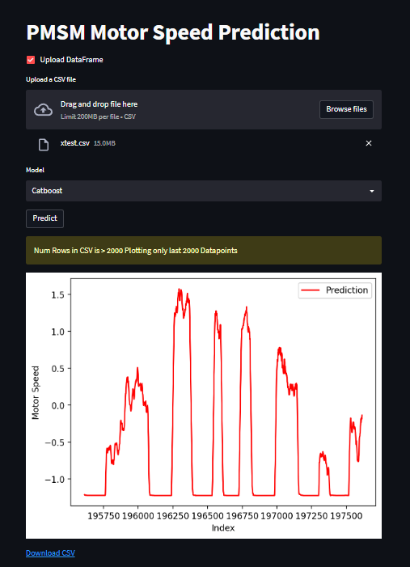
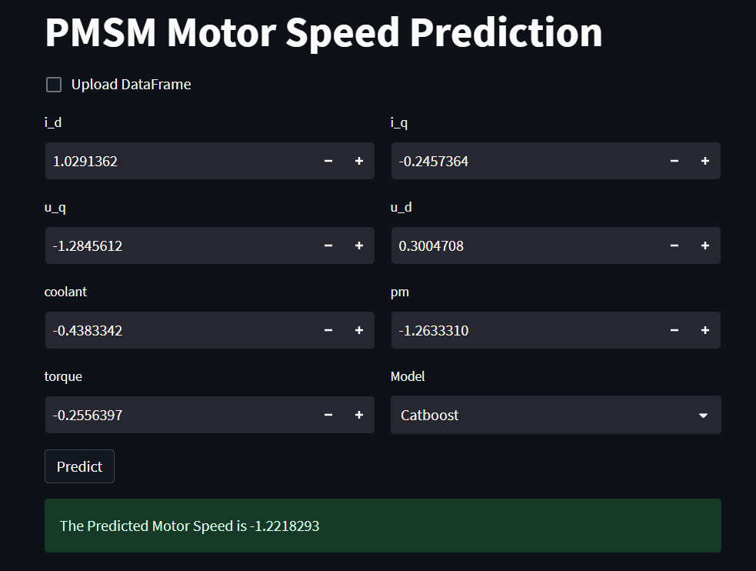
Deployment
For Deployment we used Streamlit, which provides us with an easy to deploy app with minimal code.

Slide 14
THANK YOU

